Slide 1
Self-Driving Cars
Eoin Fitzsimons - Adeola Agoro – Eoin Smyth

Slide 2
Table Of Contents
Introduction
Past
Present
Future
Final Thoughts

Slide 3
Introduction
What is a self-driving car?
Why are we interested?

Slide 4
The Past
Conceptualization in the 1920s
Early inception of autonomous vehicle concepts.
Limited progress due to technological limitations.
Technological Revolution in the 2000s
Advancements in processing power and technology.
DARPA Grand Challenge 2004: Initial breakthrough in autonomous vehicle racing.
Early Pioneers
Overview of initial progress by DARPA Challenge participants.
Sparking curiosity and increased study in the autonomous vehicle domain.

Slide 5
The Past
Key Milestones
Waymo's Pioneering Efforts: Testing since 2009 on public roads.
Tesla's Autopilot Feature: Advanced driver assistance system, not fully autonomous.
Road to Partial Autonomy
Waymo's self-driving taxi services in specific regions.
Tesla's Autopilot: Providing sophisticated driver assistance.
Conclusion of Historical Perspective
Recap of milestones achieved in self-driving technology.
Setting the stage for the future advancements in the field.

Slide 6
The Present
…

Slide 7
The Present
Who is leading the way?
Tesla, Lesser-Known Companies

Slide 8
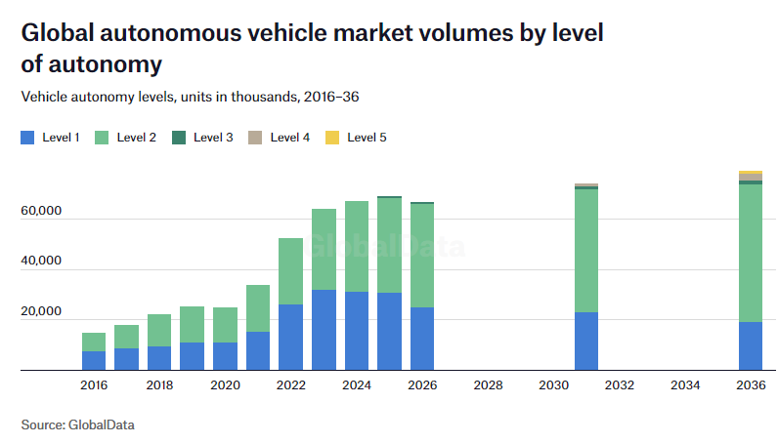
The Future
Positives
Certain disabled people will be equal to able bodied people when it comes to transport.
Negatives
Fully self-driving cars unlikely before 2035, experts predict
Stage 5 -> No human interaction required.

Slide 9

The Future
Physical Concerns
Cybersecurity
Sensors & Weather
Route Mapping
Infrastructure
Important Hypotheticals that will need to be addressed.
The dilemma of who is protected in an accident – The driver or the public?
Who pays insurance for a fully autonomous self-driving car?
Should stage 5 even be allowed, can all responsibility be taken from the “driver”?

Slide 10
Closing Thoughts
We’ve come a long way and have further to go.
When will we get there?
Is there a point to pursuing this technology?
Better alternatives such as busses and trains, better city infrastructure.

Slide 11
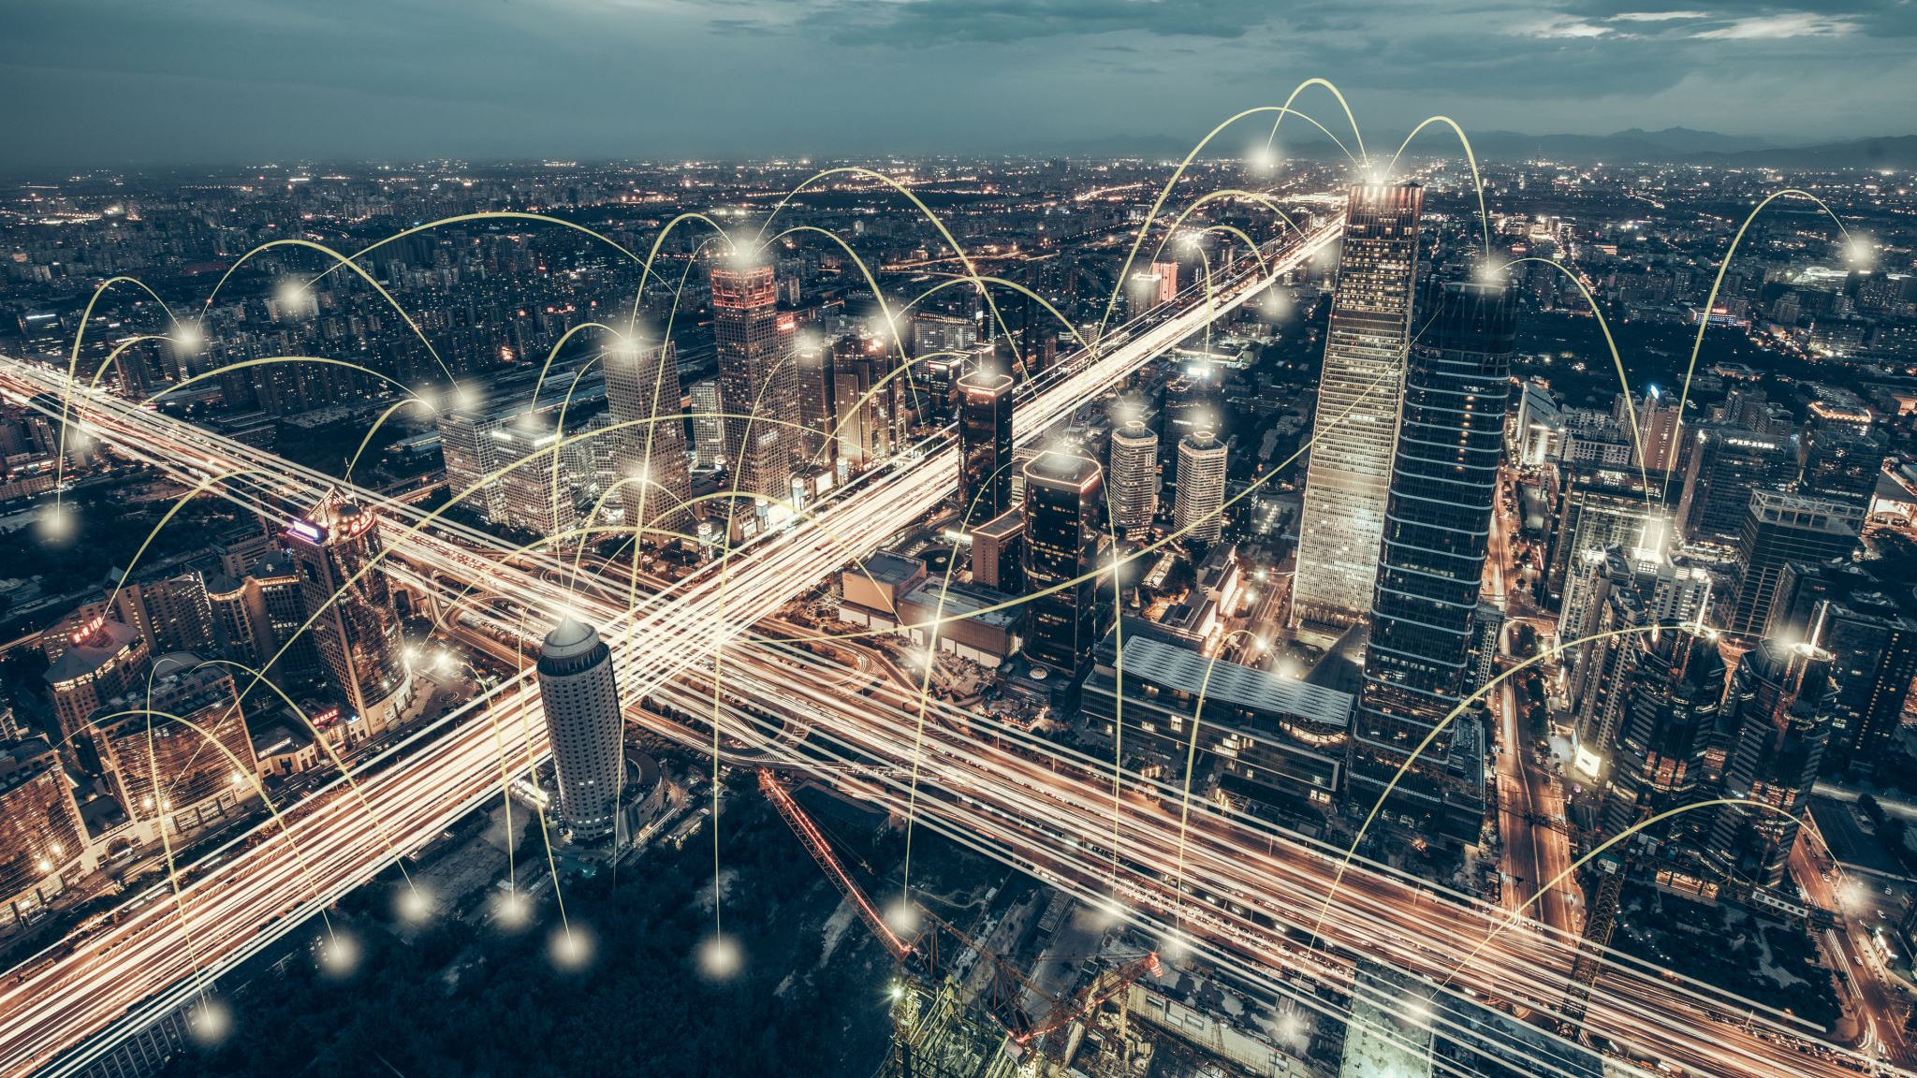

References
Tech Media and Telecom Market Analysis – Thematic Intelligence (globaldata.com)
Full self-driving cars might not be with us until 2035, experts predict (verdict.co.uk)

